Slide 1
NLP
(Natural language Processing)

Slide 2
Natural Language Tasks
Processing natural language text involves many various syntactic, semantic and pragmatic tasks in addition to other problems.

Slide 3
2) Semantic Tasks

Slide 4
Word Sense Disambiguation (WSD)
Words in natural language usually have a fair number of different possible meanings.
  Ellen has a strong interest in computational linguistics.
  Ellen pays a large amount of interest on her credit card.
For many tasks (question answering, translation), the proper sense of each ambiguous word in a sentence must be determined.
Sense: understanding

Slide 5
Word sense ambiguity is a pervasive (physically effect) characteristic of natural language. For example, the word "cold" has several senses and may refer to a disease, a temperature sensation, or an environmental condition. The specific sense intended is determined by the textual context in which an instance of the ambiguous word appears.

Slide 6
In "I am taking aspirin for my cold" the disease sense is intended, in "Let's go inside, I'm cold" the temperature sensation sense is meant, while "It's cold today, only 2 degrees", implies the environmental condition sense.

Slide 7
Semantic Role Labeling (SRL)
Sometimes also called shallow semantic parsing.
It is a process in natural language processing that assigns labels to words or phrases in a sentence that indicate their semantic role in the sentence.
For example, given a sentence like "Mary sold the book to John", the task would be to recognize the verb "to sell" as representing the predicate.
Predicate is a part of sentence that tell us what the subject does…
Semantic Role Labeling "Mary" as representing the seller (agent), "the book" as representing the goods (theme), and "John" as representing the recipient or receiver .
This is an important step towards making sense of the meaning of a sentence. ( sense: understanding)
For instance, the sentence "The book was sold by Mary to John" has a different syntactic form, but the same semantic roles.
Notes:
He stole my bike last week….. Stole
Subject Predicate verb

Slide 8
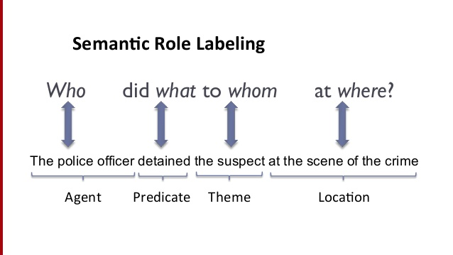
Semantic Role Labeling (SRL)……

Slide 9
Textual Entailment
Textual entailment (TE) in natural language processing is a directional relation between text fragments. The relation holds whenever the truth of one text fragment follows from another text.
Textual entailment is the task of deciding, given two text fragments, whether the meaning of one text is entailed (can conclude ) from another text.
In the TE framework, the entailing and entailed texts are termed text (t) and hypothesis (h)

Slide 10
Examples
Textual entailment can be illustrated with examples of three different relations:
An example of a positive TE (text entails hypothesis) is:
text: If you help the needy, God will reward you.
hypothesis: Giving money to a poor man has good consequences.
An example of a negative TE (text negate hypothesis) is:
text: If you help the needy, God will reward you.
hypothesis: Giving money to a poor man has no consequences.
An example of a non-TE (text does not entail nor negate) is:
text: If you help the needy, God will reward you.
hypothesis: Giving money to a poor man will make you a better person.

